Slide 1
CSC 735 – Data Analytics
Chapter 15
How Spark Runs on a Cluster

Slide 2
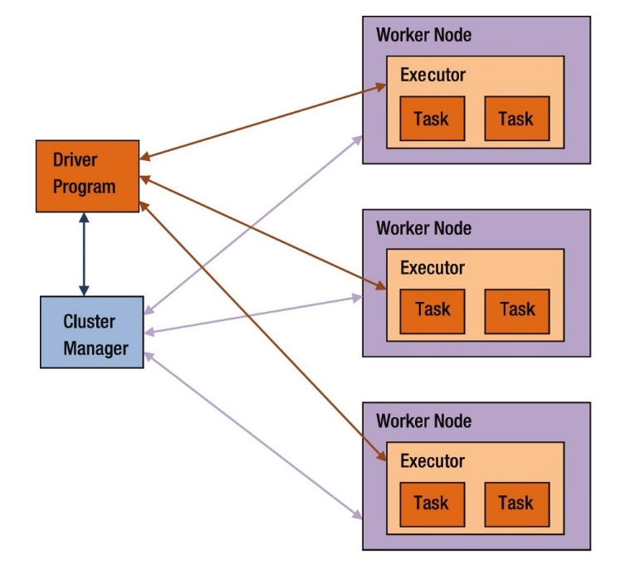
The Architecture of a Spark Application
A Spark application consists of:
driver program
a cluster manager
workers
executors, and
tasks

Slide 3
More about The Cluster Manager
A cluster manager has its own driver (aka master) and worker abstractions
They are tied to physical machines
machine on the left is the Cluster Manager Driver Node
circles represent daemon processes running on and managing each of the individual worker nodes
Basic cluster setup

Slide 4
Application Execution Modes
An application can run in one of three execution modes
Cluster mode
Client mode
Local mode

Slide 5
Spark’s Cluster Mode
Legend
Spark driver process
Executor process

Slide 6
Spark’s Client Mode
gateway machines (aka edge nodes)

Slide 7
Spark’s Local Mode
The entire application runs on a single machine
Threads are used for parallelism
Good to learn Spark or to test your applications
Not recommended for production mode

Slide 8
The Life Cycle of a Spark Application (Outside Spark)
Assume an application is submitted to a cluster consisting of 4 nodes: a cluster manager driver and three worker nodes
What is the Application’s life cycle from initialization until program exit?

Slide 9
Client Request
You make a request to the cluster manager driver node to run an application
requesting resources for the Spark driver process only
Cluster manager accepts the request
It places the Spark driver onto a worker node
The client process that submitted the original job exits
Your application is running on the cluster

Slide 10
Launch
driver begins running user code
code must include a SparkSession
SparkSession communicates with the cluster manager, asking it to launch executors
cluster manager launches the executors
it sends their locations to the Spark driver
After everything is hooked up correctly, you have a Spark Cluster

Slide 11
Execution
Spark executes the code
The driver and the workers communicate among themselves, executing code and moving data around
driver schedules tasks onto the executors
each executor responds with the status of those tasks and success or failure

Slide 12
Completion
After application completes, the driver process exits with either success or failure
The cluster manager shuts down the executors allocated for the driver
You can see the success or failure of the Spark Application

Slide 13
The Life Cycle of a Spark Application (Inside Spark)
This is the life cycle of your Spark Application code
It describes what happens inside Spark when we run an application
Remember, an application consists of one or more Spark jobs

Slide 14
The SparkSession
SparkSession is the object that represents your entrance point to writing Spark code
It manages your Spark application
In interactive mode, a SparkSession object, named spark, is created automatically for you
Legacy code might use the old SparkContext pattern. This should be avoided in favor of the builder method on the SparkSession
spark.stop() //stopping a SparkSession
// Creating a SparkSession
import org.apache.spark.sql.SparkSession
val spark = SparkSession.builder().getOrCreate()

Slide 15
The SparkContext
A SparkContext object within the SparkSession represents a connection to the Spark cluster
This class allows you to communicate with Spark’s lower-level APIs, RDDs
Through a SparkContext, you can create RDDs
If you have to, you should create a SparkContext in the most general way as follows:
import org.apache.spark.SparkContext
val sc = SparkContext.getOrCreate()

Slide 16
Logical Instructions to Physical Execution
We’ll look at how Spark takes the code and runs it on the cluster
Spark code consists mainly of transformations and actions
Understanding how a physical execution plans is generated is important to understanding how Spark runs on a cluster
If code is run in a Spark shell, start a fresh environment

Slide 17
The Code
%python
df1 = spark.range(2, 10000000, 2)
df2 = spark.range(2, 10000000, 4)
step1 = df1.repartition(5)
step12 = df2.repartition(6)
step2 = step1.selectExpr("id * 5 as id")
step3 = step2.join(step12, ["id"])
step4 = step3.selectExpr("sum(id)")
step4.collect() # 2500000000000
step4.explain()

Slide 18
Output of step4.explain()
df1 = spark.range(2, 10000000, 2)
df2 = spark.range(2, 10000000, 4)
step1 = df1.repartition(5)
step12 = df2.repartition(6)
step2 = step1.selectExpr("id * 5 as id")
step3 = step2.join(step12, ["id"])
step4 = step3.selectExpr("sum(id)")
step4.collect() # 2500000000000
step4.explain()
== Physical Plan ==
*HashAggregate(keys=[], functions=[sum(id#15L)])
+- Exchange SinglePartition
+- *HashAggregate(keys=[], functions=[partial_sum(id#15L)])
+- *Project [id#15L]
+- *SortMergeJoin [id#15L], [id#10L], Inner
:- *Sort [id#15L ASC NULLS FIRST], false, 0
: +- Exchange hashpartitioning(id#15L, 200)
: +- *Project [(id#7L * 5) AS id#15L]
: +- Exchange RoundRobinPartitioning(5)
: +- *Range (2, 10000000, step=2, splits=8)
+- *Sort [id#10L ASC NULLS FIRST], false, 0
+- Exchange hashpartitioning(id#10L, 200)
+- Exchange RoundRobinPartitioning(6)
+- *Range (2, 10000000, step=4, splits=8)

Slide 19
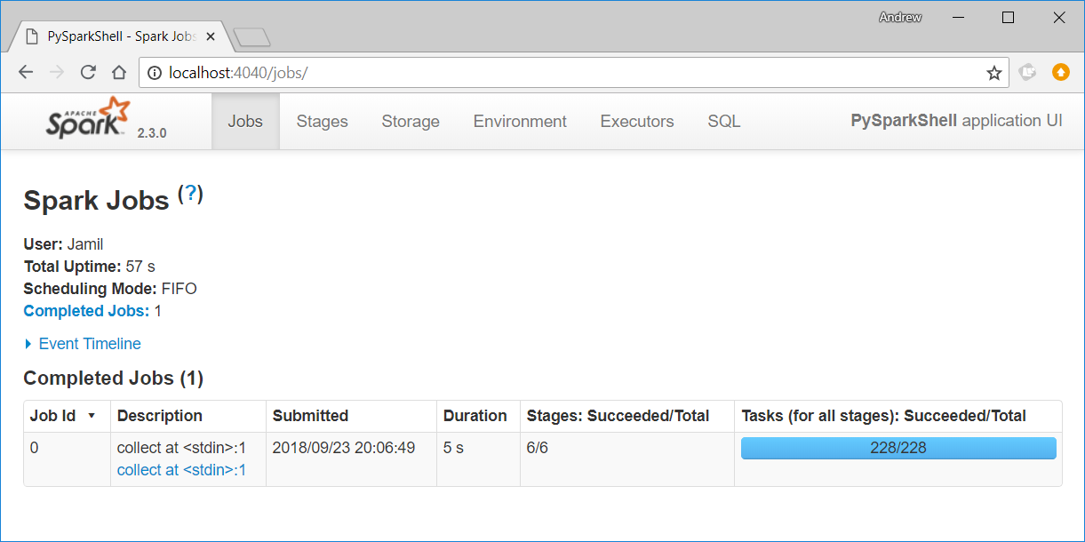
Spark UI
If code is run on the local machine, you can view Spark UI at url localhost:4040

Slide 20
A Spark Job
Generally, there is one job for each action
Spark splits a job into a DAG of stages using shuffle boundaries
This job breaks down into the following stages and tasks:
Stage 1 with 8 Tasks
Stage 2 with 8 Tasks
Stage 3 with 6 Tasks
Stage 4 with 5 Tasks
Stage 5 with 200 Tasks
Stage 6 with 1 Task
df1 = spark.range(2, 10000000, 2)
df2 = spark.range(2, 10000000, 4)
step1 = df1.repartition(5)
step12 = df2.repartition(6)
step2 = step1.selectExpr("id * 5 as id")
step3 = step2.join(step12, ["id"])
step4 = step3.selectExpr("sum(id)")
step4.collect() # 2500000000000

Slide 21
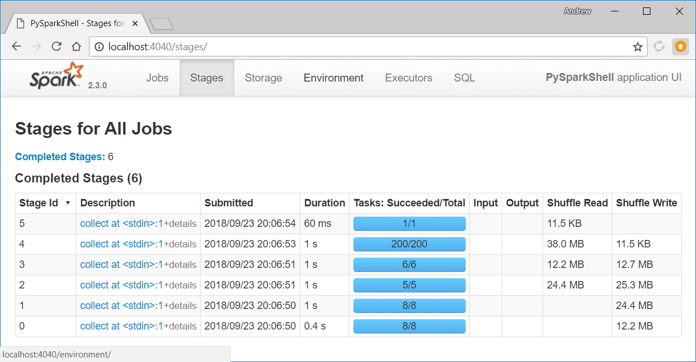
Stages

Slide 22
Stages
A stage is a group of tasks that can be executed together to compute the same operation on multiple machines
Spark will try to pack as much work as possible into the same stage
Spark starts new stages after shuffle operations
A shuffle represents a physical repartitioning of the data
sorting or grouping by key
Spark keeps track of the order stages must run

Slide 23
Stages (cont.)
By default, when range is used to create a DF, it has eight partitions
Repartitioning changes the number of partitions by shuffling the data
The DFs are shuffled into 5 and 6 partitions, corresponding to the number of tasks in stages 3 and 4
df1 = spark.range(2, 10000000, 2)
df2 = spark.range(2, 10000000, 4)
step1 = df1.repartition(5)
step12 = df2.repartition(6)
Stage 1 with 8 Tasks
Stage 2 with 8 Tasks
Stage 3 with 6 Tasks
Stage 4 with 5 Tasks

Slide 24
Stages (cont.)
step2 is a value-by-value manipulation in stage 4
step2.join(step12, ["id"]) is a join (shuffle)
By default, when a shuffle is performed during execution, it outputs 200 shuffle partitions
sum(id) aggregates individual partitions and brings results to 1 partition
collect() sends the final result to the driver
df1 = spark.range(2, 10000000, 2)
df2 = spark.range(2, 10000000, 4)
step1 = df1.repartition(5)
step12 = df2.repartition(6)
Stage 1 with 8 Tasks
Stage 2 with 8 Tasks
Stage 3 with 6 Tasks
Stage 4 with 5 Tasks
step2 = step1.selectExpr("id * 5 as id")
step3 = step2.join(step12, ["id"])
step4 = step3.selectExpr("sum(id)")
step4.collect() # 2500000000000
Stage 5 with 200 Tasks
Stage 6 with 1 Task

Slide 25
Changing Number of Partitions for a Shuffle
By default, a shuffle outputs 200 partitions
This code changes that:
A good rule of thumb:
on a cluster, the number of partitions should be larger than the number of executors
on local mode, the number of partitions should be lower than the number of executors
spark.conf.set("spark.sql.shuffle.partitions", "10")

Slide 26
Tasks
A stage consists of tasks
Each task corresponds to a set of transformations applied to a unit of data (the partition)
A task runs on an single executor
If there is one big partition in our dataset, we will have one task
If there are many little partitions, we will have many tasks that can be executed in parallel
Partitioning your data into a greater number of partitions means that more parallelism

Slide 27
Pipelining
Pipelining is automatic optimization done by Spark
Any sequence of operations that feed data directly into each other, without needing to move it across nodes, is pipelined into a single stage of tasks
Ex: a map/select operation followed by a filter followed by a map/select
Spark is fast as it performs as many steps as possible before writing data to memory or disk

Slide 28
Shuffle Persistence
Another optimization technique done by Spark
Whenever a shuffle operation is performed, Spark writes the result to permanent storage
Any subsequent operation that depends on that shuffle will start by reading the data from storage
Shuffle operations do not need to be executed again
This also makes Spark run faster

